Slide 1
Predictions of Critical Thermal Maxima for Salmonids of Increasing Size
Lucas Fischer

Slide 2

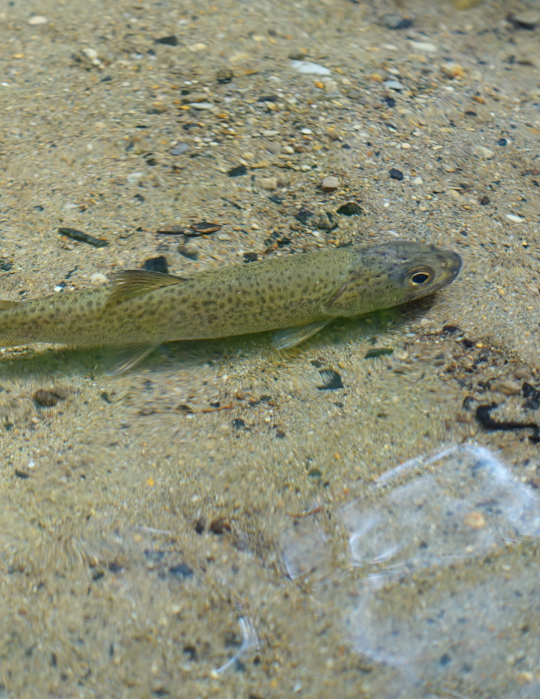
Why This Matters?
Worldwide water temps are increasing with climate change
Species like salmon are going to be faced with temperatures beyond their adaptive range (Pletterbauer et. al. 2015; Xu et al. 2024).
Already Southern populations are collapsing.
My research was focused on salmon relatives in Japan
Currently there is no published research regarding this topic.
Of the two species studied, Ito are listed as currently endangered (Rand, 2006).

Slide 3
Methods
My research had two focuses: metabolism, and thermal tolerance
This report is focused on the thermal tolerance, approximating the critical thermal maxima
Critical Thermal Maxima (Ctmax) is an operational value that is used to compare to other studies with the same method
It (usually) refers to a theoretical temperature limit where an organism loses motor control

Slide 4
Methods
Because our data is restricted to fish ~ 50g and smaller, we want to determine if there is any difference for fish that are larger-bodied
R analysis
Using linear models
Part 1 is model selection to determine if other factors other than Spp. and mass play a role in Ctmax
logLik() & lrtest()
Create a dataset for the two species represented, but with masses double those that we observed
After finding the best model, we use it to predict data beyond the range of values seen
Predict()
Then compare the predicted with the observed, as well as between spp.
Ggplot()

Slide 5
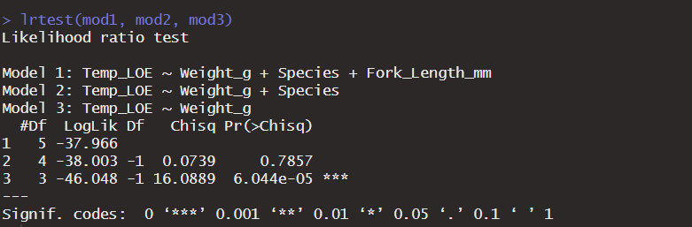
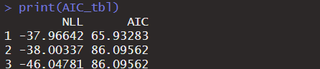
Model Selection
We decide to go with Model 1, factoring in Species and Length

Slide 6
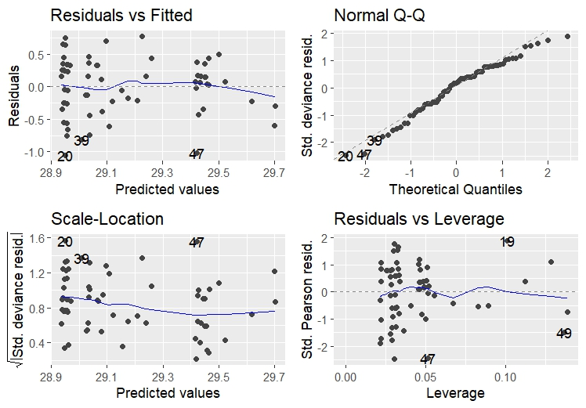
Assumption Checking

Slide 7
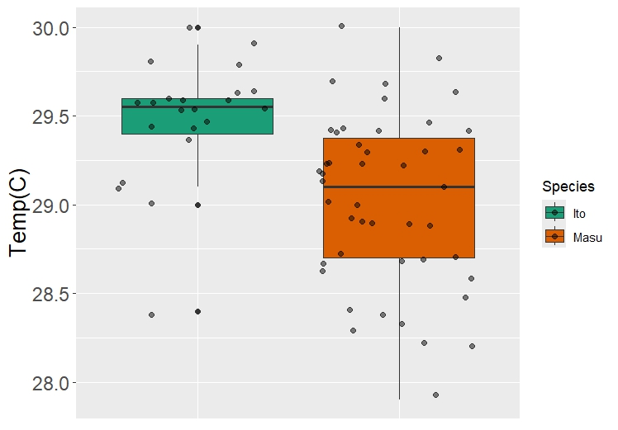

Slide 8
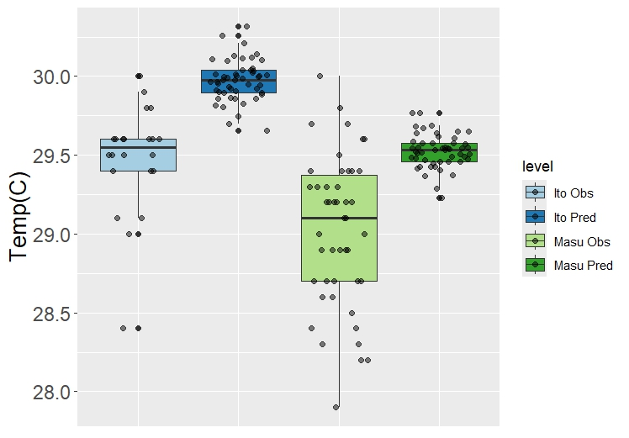

Slide 9
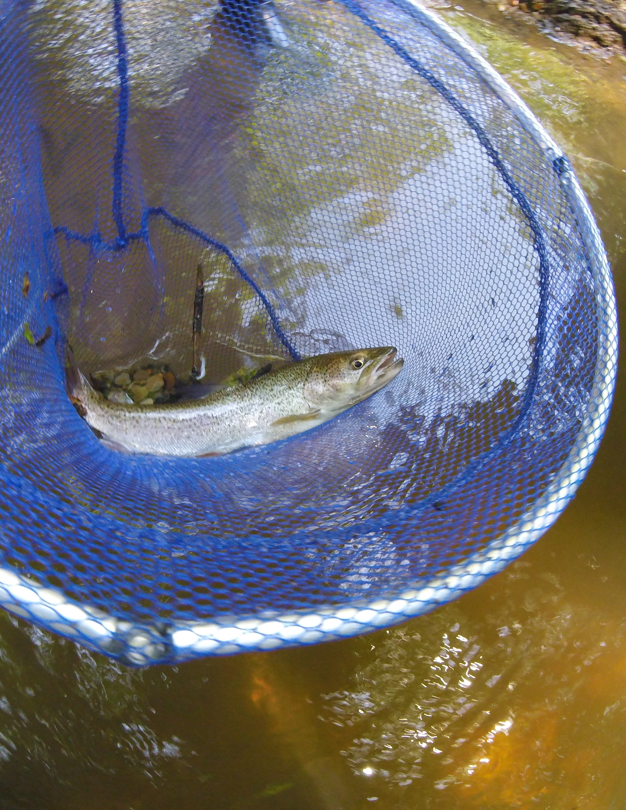
Ecological Meaning
Ito CTmax is predicted to remain higher than masu as body size increases
The difference in CTmax means between observed and predicted in ito is greater than in masu, which indicates that ito CTmax scales to larger body size compared to Masu
Length is non-linear to weight, so that needs to be addressed
Ito are generally longer and thinner compared to Masu
CTmax may be impacted by body shape?
Further testing

